Slide 1
MARKETING CAMPAIGN ANALYSIS

Slide 2
INTRODUCTION
The Marketing dataset consist of 8 categorical columns and 8 numerical columns, which helps identify key groupings within the data.
The goal of this review is to leverage these data points to gain insights into:
Campaign Performance
CTR
CPC
Conversion Rates etc.
By analyzing the dataset through various visualization and aggregation techniques,
we can derive meaningful insights that will help the company make informed decisions on inventory management, sales strategies, and marketing campaigns, ultimately improving overall product performance.

Slide 3
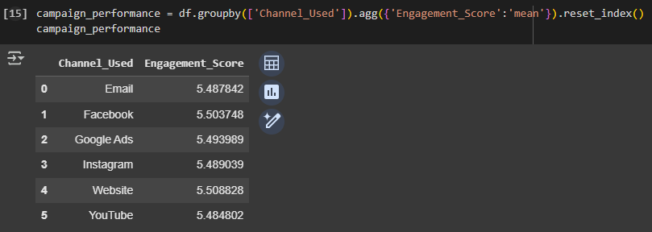
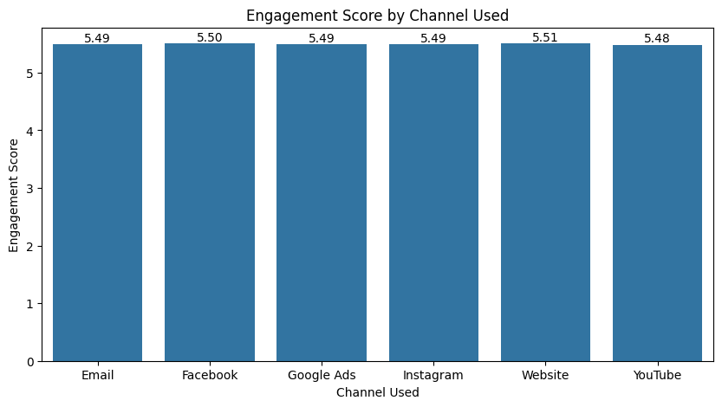
OBSERVATIONS
Calculating the average of engagement score /10 ,helps us understands each channel performance based on their average.
From our visuals ,we can see that website is the most effective channel for engaging the audience, we can also see Facebook and Google ads are performing well also ,with Youtube as the lowest performing channel.
But the scores are very close to each other, with only small differences between them. This could imply that all channels are performing similarly, with minor variations.

Slide 4


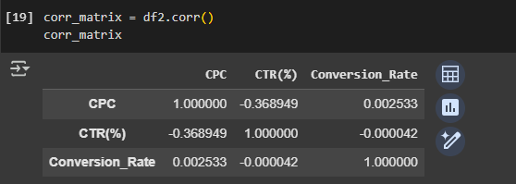
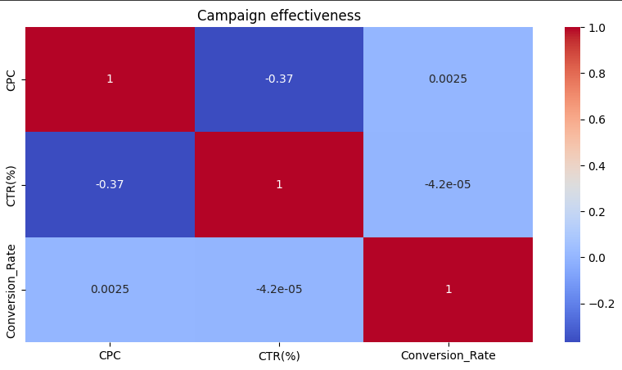
Calculated CPC(cost per clicks) and CTR(click through rates) ,then checked the correlation between CPC, CTR and conversion rate.
From our heatmap below ,it shows that
As the CPC increases, the CTR tends to decrease. This could indicate that higher ad costs does not necessarily lead to more clicks relative to impressions.
Also show a weak positive correlation between CTR and conversion rate, A higher CPC does not seem to have much of an effect on the conversion rate (the rate at which clicks lead to conversions). This suggests that paying more per click is not significantly influencing how many of those clicks turn into conversions.
There is no meaningful relationship between clicks and conversions, indicating that a higher click rate doesn't necessarily improve conversion rates.

Slide 5
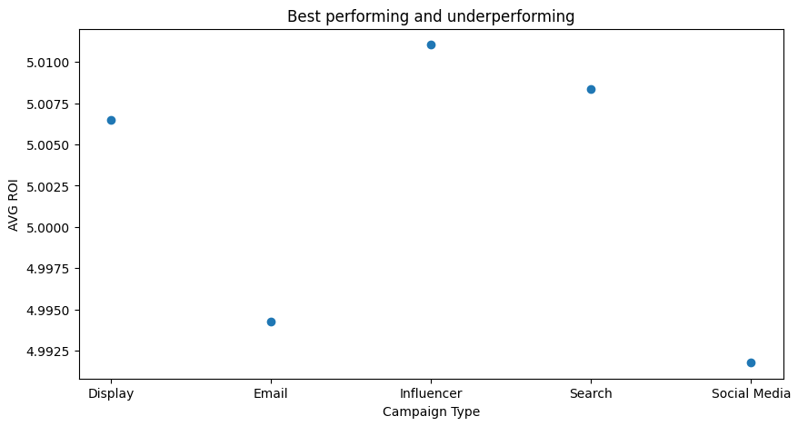
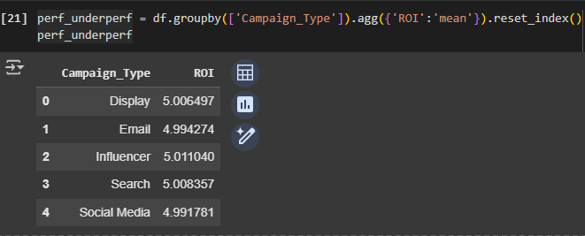
Calculated the average performance of ROI(return of investment) on each campaign types and from our visuals , For every $1 spent on a display campaign, the company earns approximately $5.01 in return,
providing a strong return on investment. A 5x return is generally considered quite profitable. Email campaign also earns about $4.99 in returns ,same as other campaign types .
All campaigns have a strong ROI, delivering close to 5x the investment, which indicates that the company's marketing strategy is performing well.
Influencer and Search campaigns have the highest ROI, slightly outperforming the other campaign types.
Social Media and Email campaigns, while slightly lower in ROI, are still very profitable but might benefit from targeted optimization.

Slide 6
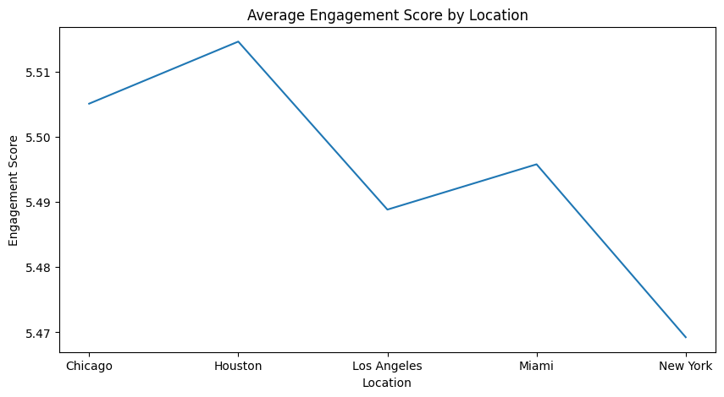
The chart shows that Houston has the highest engagement score among the locations. This suggests that marketing campaigns or other engagement strategies are resonating the most with the audience in Houston. Chicago and Miami also show strong performance, with relatively high engagement scores, indicating good campaign success in these areas.
On the other hand, New York is performing the lowest in terms of engagement, meaning that the campaigns might not be as effective there. This could be an indication that the strategies used in New York need improvement or that the audience in that region isn't responding as expected.

Slide 7
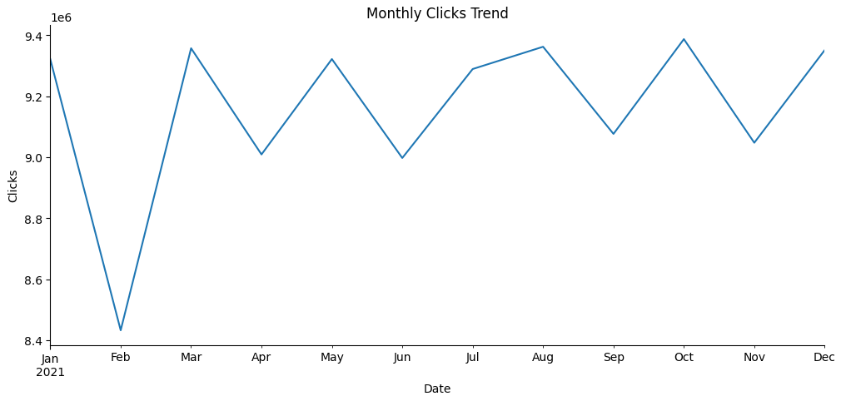
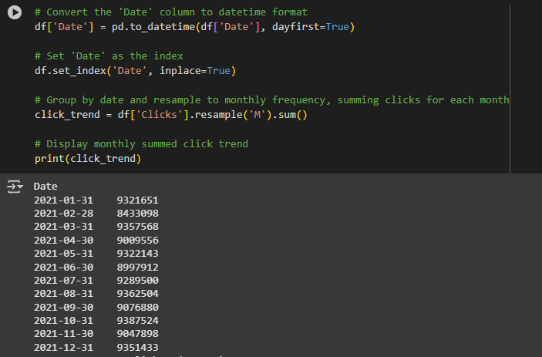
The visual illustrates the monthly trend of campaign clicks throughout the year.
February: There is a significant downward trend in clicks, meaning this month performed poorly in terms of audience engagement.
April, June, September, and November: These months also show downward trends, although less severe than February. This suggests the campaigns were less effective during these months compared to others.
Other months: These months experienced upward trends, showing improvement in clicks and better audience interaction.

Slide 8
RECOMMENDATIONS
Focus on Channels Generating Engagement:
Channels that are already generating good engagement should be prioritized. These are the channels where the audience is actively interacting, so identifying the strategies that are working there can help maximize their impact. However, it’s important not to ignore channels with lower engagement; instead, work on enhancing them by adapting strategies that have succeeded in the higher-engaging channels.
Boost Conversion Rates:
Since CPC (Cost-Per-Click) and CTR (Click-Through Rate) do not have a strong correlation with conversion rates, other strategies should be explored to improve conversions. This might include optimizing landing pages, improving user experience, enhancing call-to-action elements, or creating more targeted and relevant content that aligns with audience needs.
Re-Evaluate CPC:
As the data shows that CPC has little effect on CTR, it's important to reassess how much you’re spending per click and whether this spend is justified. The goal should be to optimize CPC while still ensuring you maintain or improve overall engagement and conversion. You could explore more efficient bidding strategies or allocate budget differently across campaigns.
Campaign Platforms and ROI:
While campaign platforms are performing well in terms of ROI (Return on Investment), there’s room to improve their overall profitability. This could involve reducing campaign costs, increasing the volume or quality of traffic, or optimizing conversion paths. By doing this, campaigns can become more cost-efficient, yielding higher returns not only in financial terms but also in broader marketing objectives like brand awareness or customer engagement.

Slide 9
Improving Engagement in Low-Performing Locations:
Locations like New York and Los Angeles, which are underperforming in engagement, need more focus. It’s important to understand why these locations aren’t responding as well. This could involve tailoring the content to suit local demographics, adjusting targeting parameters, or introducing more localized marketing strategies. At the same time, continue to improve the performance of high-engagement locations (like Houston, Chicago, and Miami). While these are already performing well, there’s always potential to push their results even further with optimized strategies.
Addressing Low-Performing Months:
Analyze the reasons why certain months see a decline in clicks and engagement. For example, February and other lower-performing months could be due to seasonal factors, holidays, or less impactful campaigns. To improve these months, consider introducing new marketing strategies such as timely promotions, enhanced ad creatives, or retargeting initiatives. Identifying what works well in higher-performing months (like August) and replicating those tactics could help lift performance in the weaker months
CONCLUSION
Maximizing engagement and profitability from existing channels and platforms.
Improving underperforming locations and months through strategic, targeted efforts.
Re-evaluating cost metrics like CPC to ensure spending is justified and yielding returns.

